Slide 1

CCPS 506
Comparative Programming Languages
Fall 2019
Lecture 2: More advanced Smalltalk

Slide 2
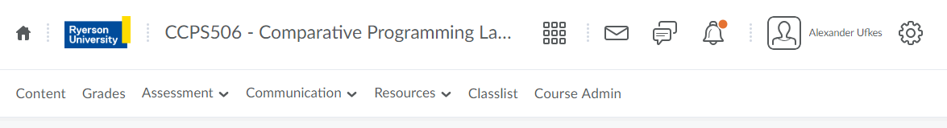
Course Administration
Announcements related to this course will be made on D2L. Be sure to check regularly!
Grades, assignments, and labs will be posted to D2L.
The course outline can also be found there.

Slide 3
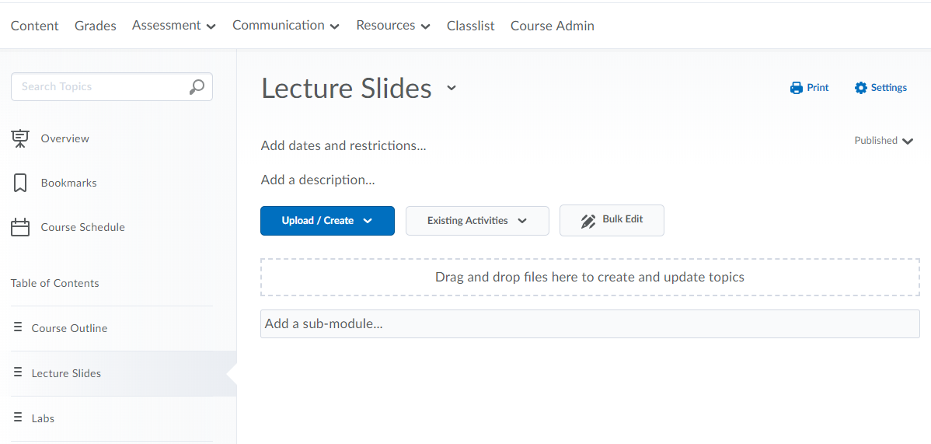
D2L Course Content

Slide 4
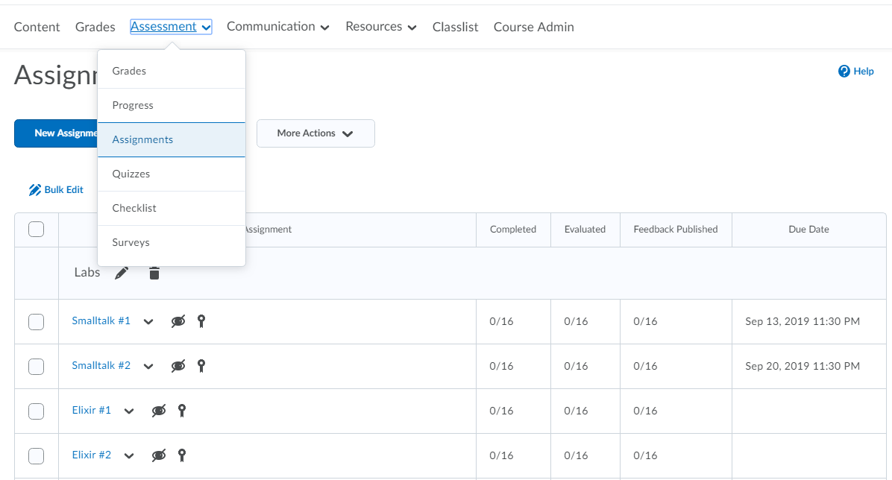
D2L Course Content

Slide 5
Regarding Deadlines
From the CMF:
Late Submissions
Late submissions will be penalized at a rate of 2^{n} %, where n is the number of days late. One day late is a 2% penalty, two days 4%, three days 8%, four days 16%, and so on.
The penalty for a couple days late is small, but it ramps up quickly.
Don’t despair if you miss the due date by a day or two, it has very little effect.

Slide 6

Any Questions?

Slide 7
Let’s Get Started!

Slide 8
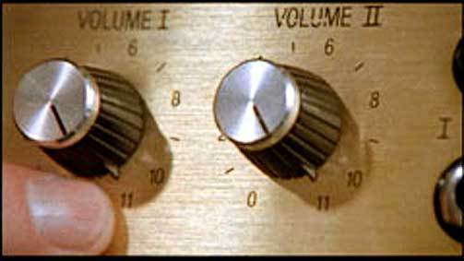
Smalltalk: OOP cranked up to 11

Slide 9

Objects in Smalltalk
Everything is an object. Everything is an instance of a corresponding class
A Smalltalk object can do exactly three things:
Hold state (assignment)
Receive a message (from itself or another object)
Send message (to itself or another object)
Message passing is central in Smalltalk.

Slide 10
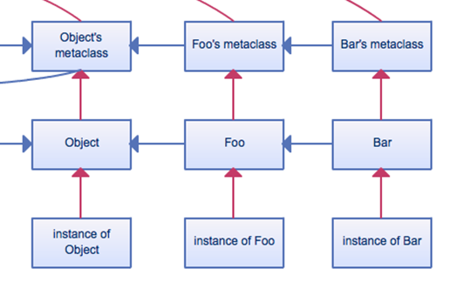
Message Passing
Passing a message to an object is semantically similar to invoking its methods:
When a message is sent to an object:
Search the object’s class for an appropriate method to deal with the message.
Not found? check superclass (inheritance!)
Repeat until method is found, or we hit class “Object”. Much like Java.
Still not found? Throw exception.

Slide 11
Example: What is the Result?
Which messages are unary? Binary? Keywords?
3 factorial + 4 factorial between: 10 and: 100
factorial gets sent to 3, then 4.
6 + 24 between: 10 and: 100
+ is sent to 6 with 24 as argument
30 between: 10 and: 100
between:and: sent to 30 with 10 and 100 as arguments
30 between: 10 and: 100
True!

Slide 12
Continuing on…

Slide 13
Today
Continuing study of Smalltalk:
More advanced syntax:
Blocks
Control “Structures”
A few other collections
Method “Overloading” with double dispatch
Lab #2

Slide 14

Blocks

Slide 15
Blocks
Defined with square brackets [ ]
Within the [ ] is Smalltalk code.
[ Transcript show: 27; cr ].
This block contains familiar code – we show the Integer 27, and do a carriage return.

Slide 16
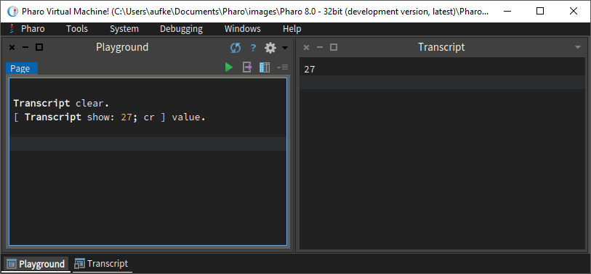
Blocks
To execute a block, pass it the “value” message

Slide 17
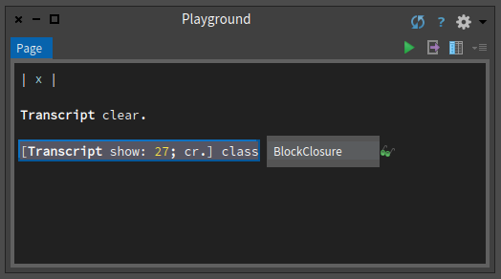
Blocks are Objects!
Highlight line, ctrl-p to print it

Slide 18
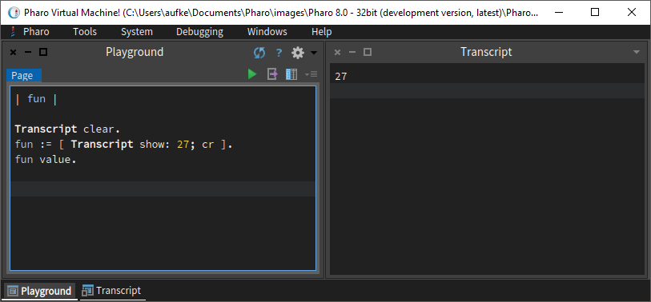
Blocks
Blocks are objects! They may be assigned to a variable:
We are passing the value message to a block object.
BlockClosure has a method called value.
Now we can execute the block using the variable:

Slide 19
Blocks as Anonymous Functions
func := [ :x | Transcript show: x; cr. ].
This is an argument. Pharo allows up to four.
B-b-b-but zero-one-infinity? Think about why this limit of four might exist in practice.
Argument(s) can be passed in when we send the keyword value: message (as opposed to the unary value message)
func value: 27.

Slide 20
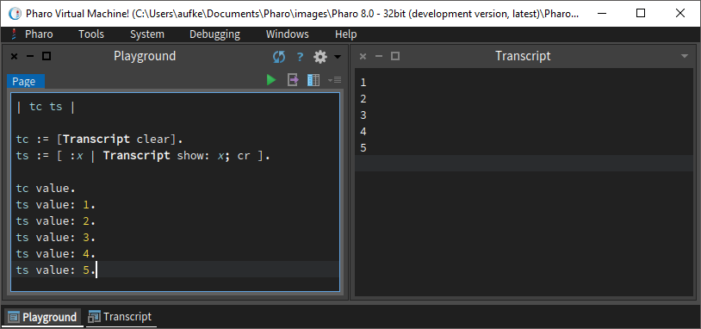
Blocks with Arguments

Slide 21
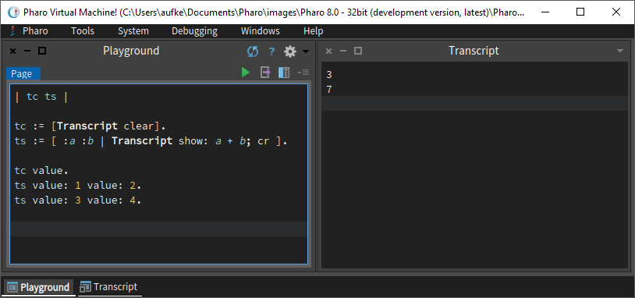
Blocks with Multiple Arguments
One arg? Keyword message value:
Two args? Keyword message value:value:
Recall how Smalltalk interleaves arguments

Slide 22
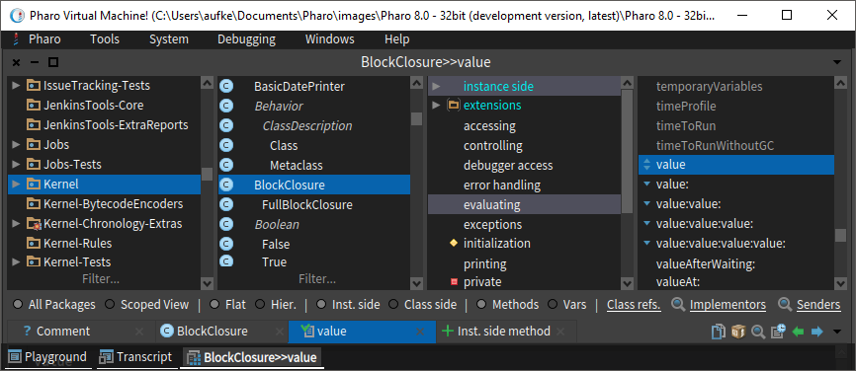
value:value:value:value:value:value:value….
What can we do if we want to pass more than 4 arguments?
Pass a single array (or some other collection) of values

Slide 23
A Brief Aside: Terminator VS Separator
func := [ :x | Transcript show: x; cr. ].
func := [ :x | Transcript show: x; cr ].
These both work. What’s the difference, if any?

Slide 24
A Brief Aside: Terminator VS Separator
In Java, semi-colon (;) is the statement terminator.
In Smalltalk, period (.) is the statement separator.
Thus, we do not need a period after the last statement we’re executing.
This applies to blocks as well. Period not required after the last statement in a block
Of course, it’s not illegal to have it there, just redundant

Slide 25
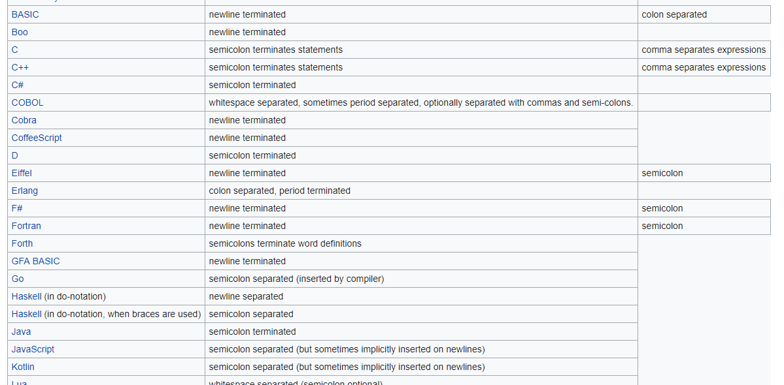

Slide 26
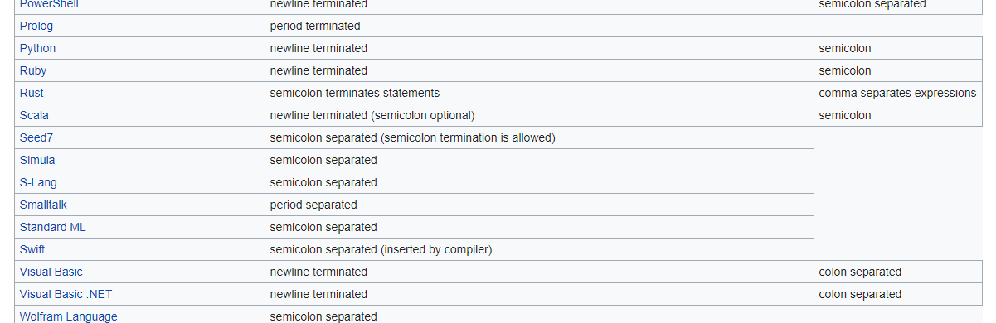

Slide 27

Nice blocks, what can you build with them?

Slide 28

Control Structures
Boolean Expressions

Slide 29
Control Structures: Branching/Selection
In Java we have special syntax for selection:
if (x > y)
System.out.println(“True”);
else
System.out.println(“False”);
Control structures in Smalltalk do not have special syntax.
They are realized using blocks and message passing!

Slide 30
Control Structures: Branching/Selection
They are realized using blocks and message passing!
7 > 4 ifTrue: [Transcript show: ‘This is true’].
7 > 4 evaluated first (why?), results in Boolean object
ifTrue: message sent to Boolean object with BlockClosure argument [‘This is true’].
Suggests that a Boolean object (True, False) knows how to handle the ifTrue: message.
Who can guess what the ifTrue: method is going to do with its argument?

Slide 31
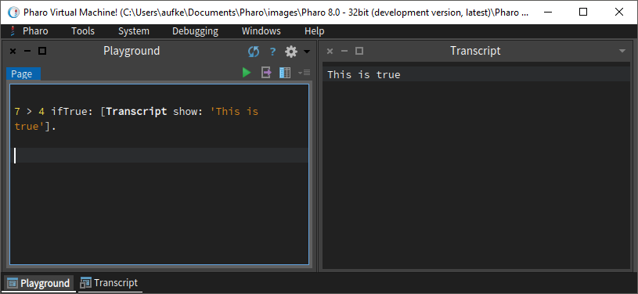
7 > 4 ifTrue: [Transcript show: ‘This is true’].

Slide 32
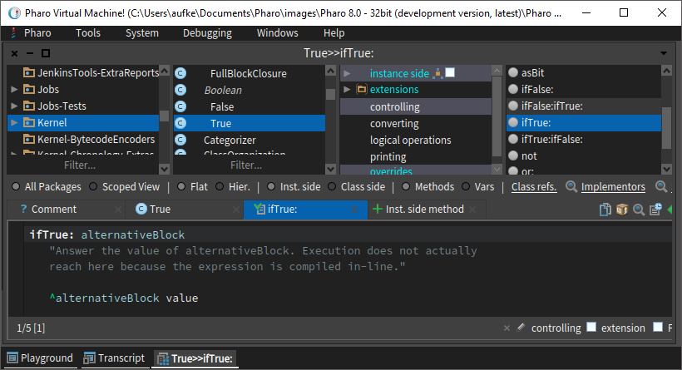
ifTrue: must be very complicated…
A True object receives the ifTrue: message.
It sends the value message to the argument.
The value message executes a block.
It really is that simple!

Slide 33
ifTrue: must be very complicated…
We can see that the ifTrue: method is returning the result of executing the block argument.
Executing the code within a block is not the same as returning something!
What gets returned when we execute a block?

Slide 34
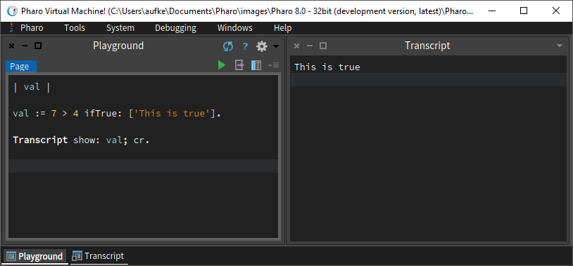
Blocks “Returning” Values
A block evaluates to the result of its last expression.
In this case, we have a single string literal, nothing else.
A literal, when evaluated, is simply itself.

Slide 35
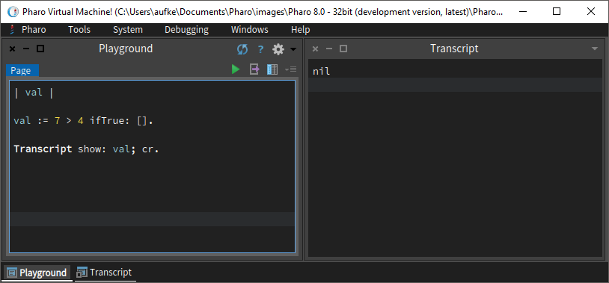
Blocks “Returning” Values
We have to return something.
If there’s nothing to return, the object nil is returned.
Smalltalk’s null.

Slide 36
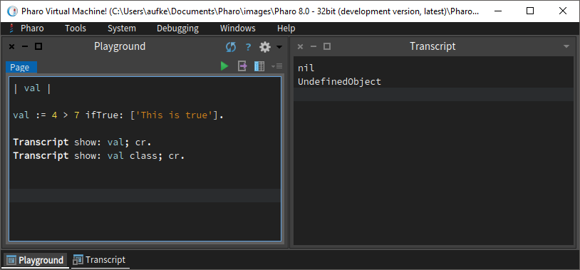
nil
Turns out…
If we send ifTrue: to a False object, we also get nil.
nil is an instance of the UndefinedObject class.
Unassigned variables are also nil

Slide 37
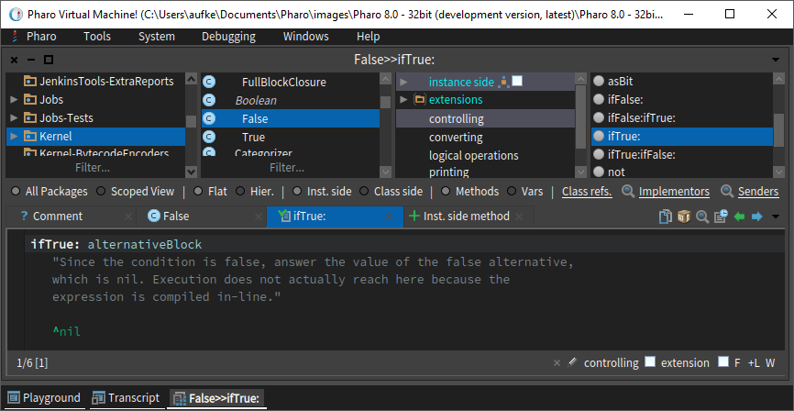
nil

Slide 38
ifTrue:ifFalse:
By now, we know this is a keyword message that takes two arguments. Both are blocks.
The block that gets executed depends on whether the message is sent to a True object or a False object.

Slide 39
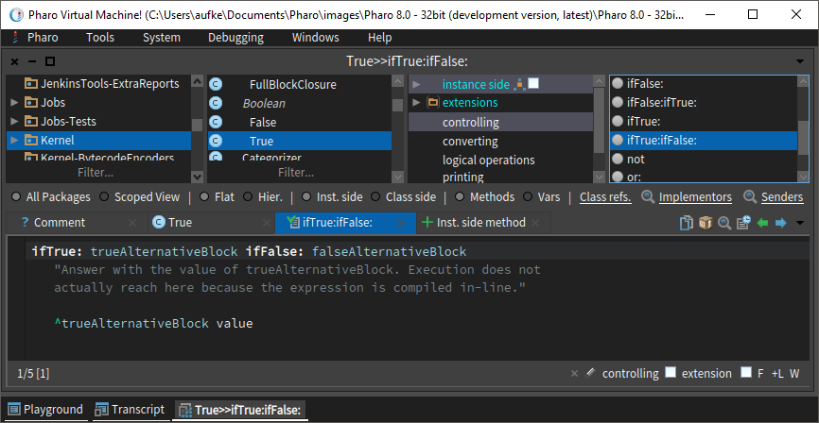
ifTrue:ifFalse:

Slide 40
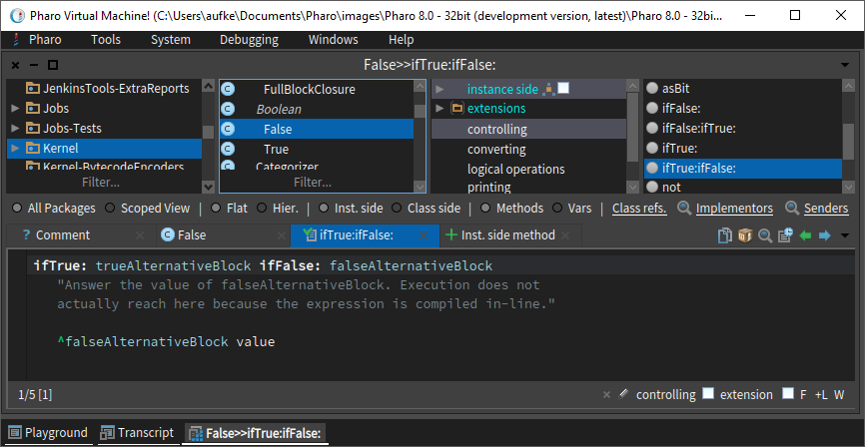
ifTrue:ifFalse:

Slide 41
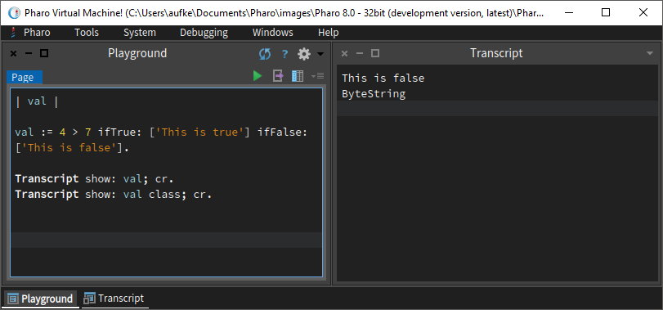
ifTrue:ifFalse:

Slide 42
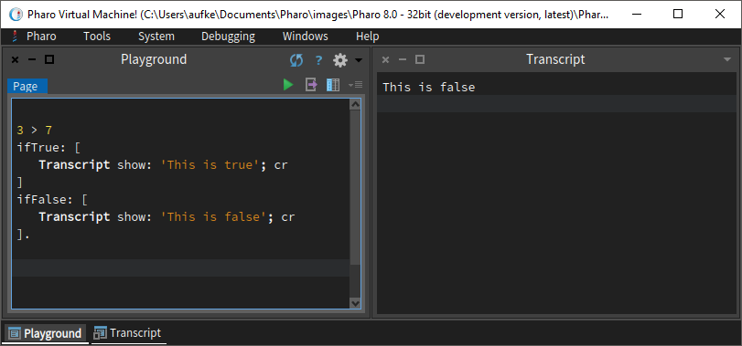
We can arrange the code to make the structure look more familiar:
Just like in Java, this “structure” operates on a Boolean condition.
It doesn’t matter what that condition is, so long as it evaluates to True or False (Boolean object)

Slide 43
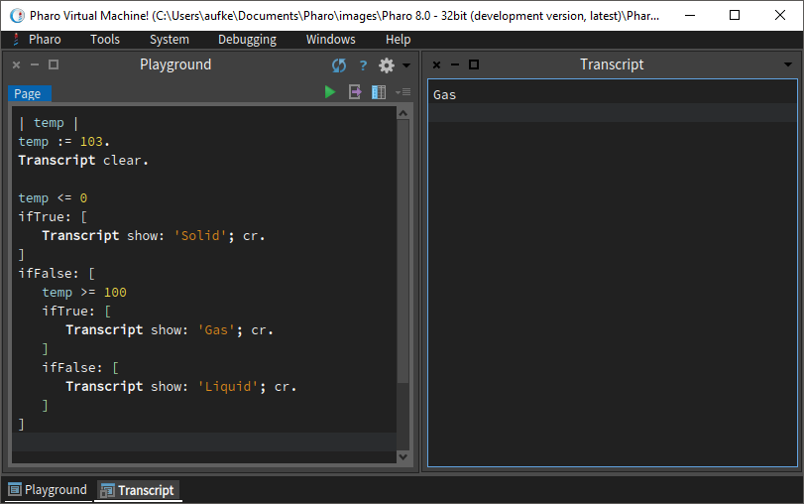
Nesting? Blocks can be nested!
If temp <= 0, execute this block
If not, execute this block

Slide 44
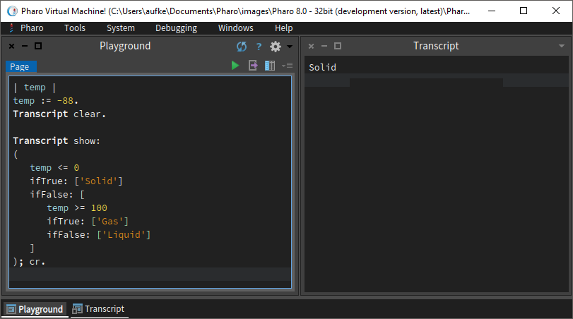
We can write this a slightly different way – the entire structure can be an input argument to show:
Now, instead of including Transcript show: statements in the blocks, we can just use the blocks to pick a string literal object to be shown.

Slide 45
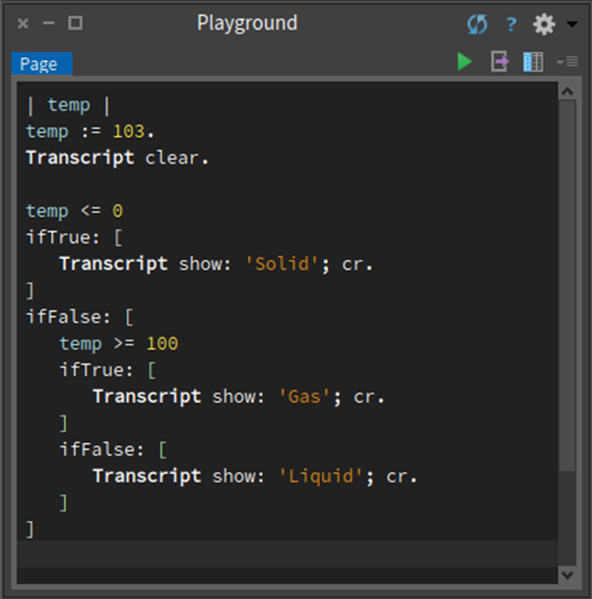
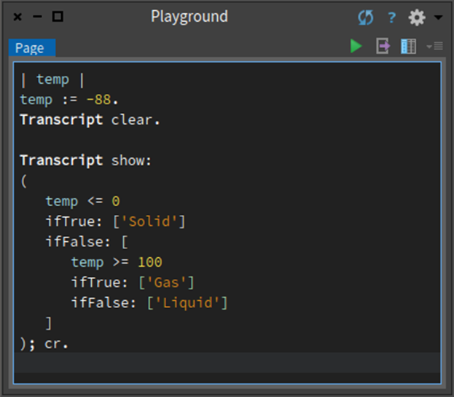
Different Syntax, Same Semantics

Slide 46
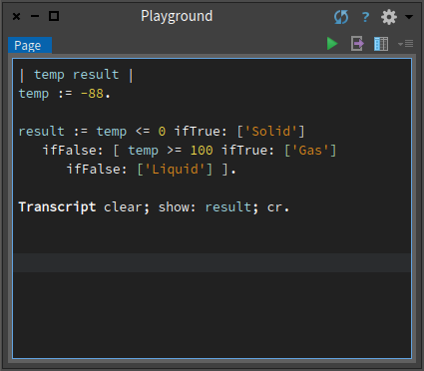
Different Syntax, Same Semantics
This is great practice – rearrange code to be as small/efficient as possible. It will help you truly understand how the syntax works.

Slide 47
temp := 88.
Does not evaluate yet!
temp <= 0 ifTrue: ['Solid'] ifFalse: [temp >= 100 ifTrue: ['Gas'] ifFalse: ['Liquid']].
This goes first!
false ifTrue: ['Solid'] ifFalse: [temp >= 100 ifTrue: ['Gas’] ifFalse: ['Liquid']].
Passed to false object
temp >= 100 ifTrue: ['Gas’] ifFalse: ['Liquid']
This goes first!
false ifTrue: ['Gas’] ifFalse: ['Liquid']
Passed to false object

Slide 48
false ifTrue: ['Gas'] ifFalse: ['Liquid'].
Passed to false object
'Liquid'
Finally, when all the message passes have been evaluated, we’re left with 'Liquid'

Slide 49

Repetition
Condition

Slide 50
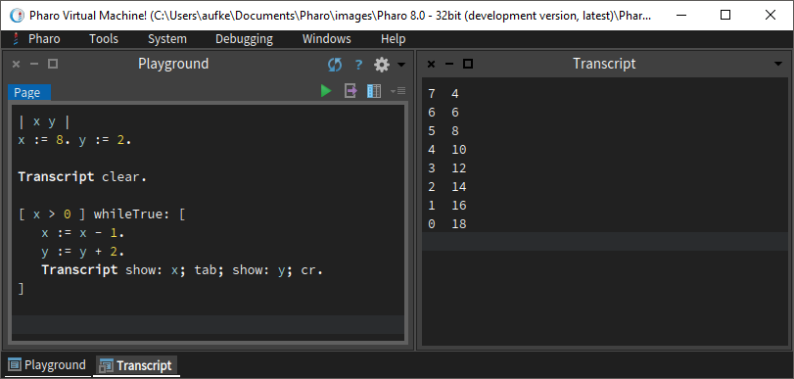
Repetition Using Messages & Blocks
What messages are sent to what objects?
whileTrue: message sent to block object with another block as an argument

Slide 51
Repetition Using Messages & Blocks
[x > 0] whileTrue: [ x := x - 1. y := y + 2. ].
whileTrue: message sent to block containing Boolean expression x > 0
The BlockClosure class understands the whileTrue: message.
The argument that accompanies the whileTrue: message is a block containing the code to be repeated.

Slide 52
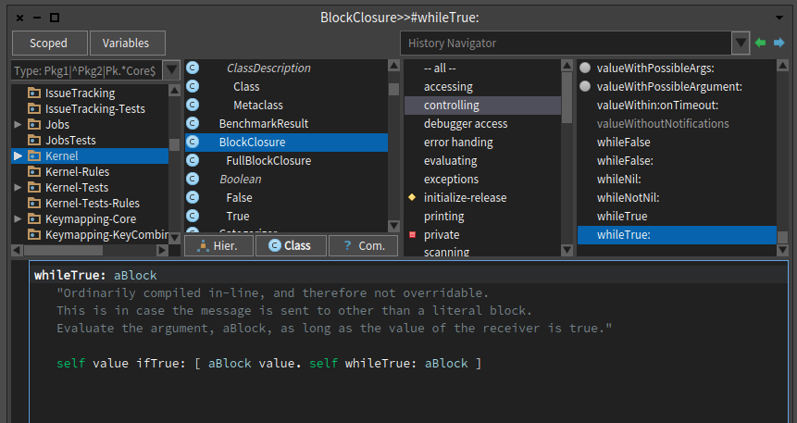
Recursive!

Slide 53
Send ifTrue: message to Boolean
Argument is a Block object
Finally, send whileTrue: once more to the same block, with the same argument.
self value ifTrue: [ aBlock value. self whileTrue: aBlock ]
Send value message to self, which executes it
self evaluates to a Bool
aBlock is the input argument first passed with the whileTrue: message
We execute it once

Slide 54
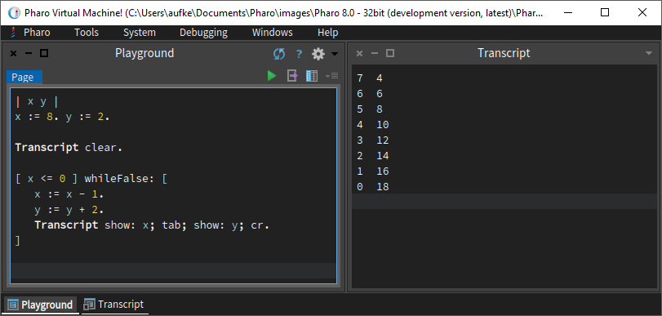
Repetition Using Messages & Blocks
Much like selection, there are many options

Slide 55
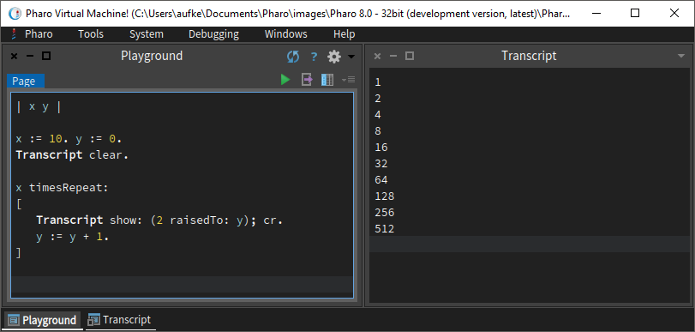
timesRepeat:
timesRepeat: is passed to a regular old integer
Argument is a block object (loop body)

Slide 56
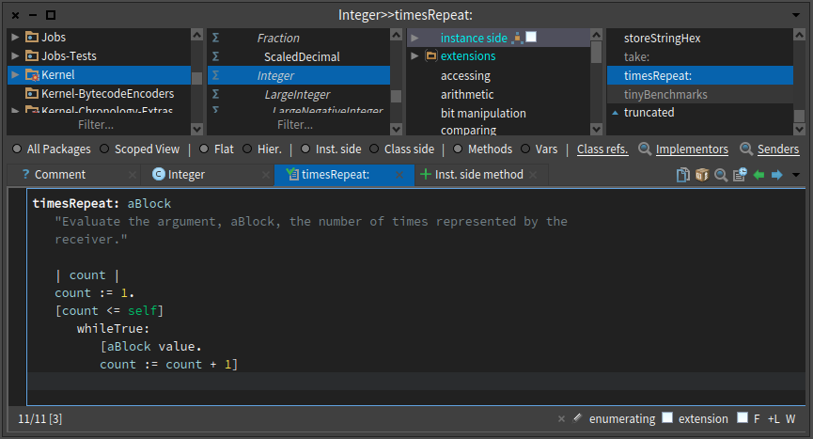
timesRepeat: is just a wrapper for whileTrue:

Slide 57
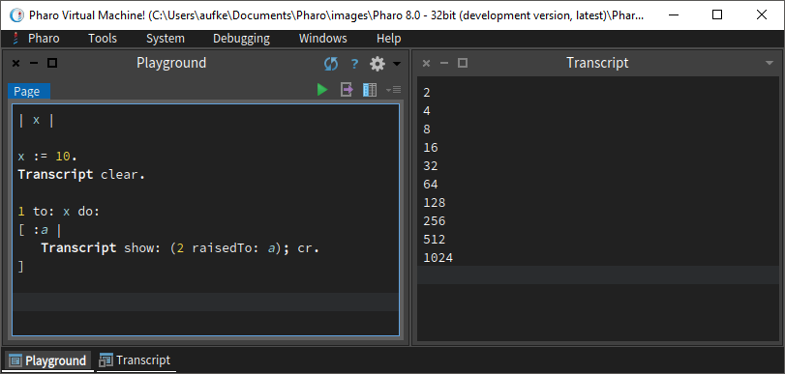
For-loop equivalent - to:do:
a is our loop index
Can be used in the “body” of the loop
to:do: message passed to an integer
Two arguments – ending index and block representing loop body.

Slide 58
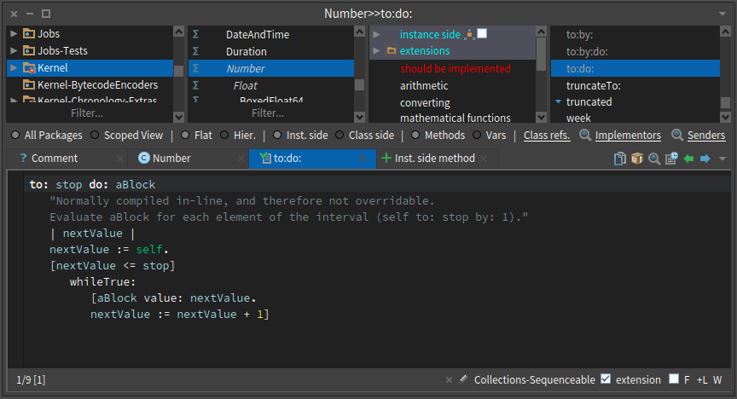
Same as timesRepeat:, just a wrapper for whileTrue:
Why is this implemented under Number, and not Integer?

Slide 59
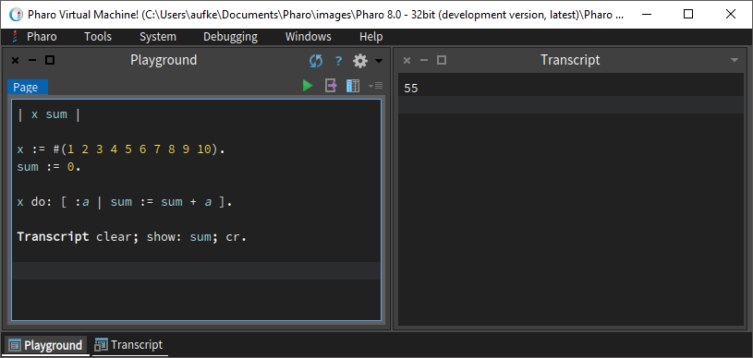
Iterate Over Arrays
Send do: message to an array object with block as argument.
Block argument is each array element
Also works with other collections

Slide 60

Other Smalltalk Collections

Slide 61
We’ve seen arrays.
In Java, we have things like ArrayLists, Vectors, LinkedLists, PriorityQueues, and so on.
What about Smalltalk?

Slide 62
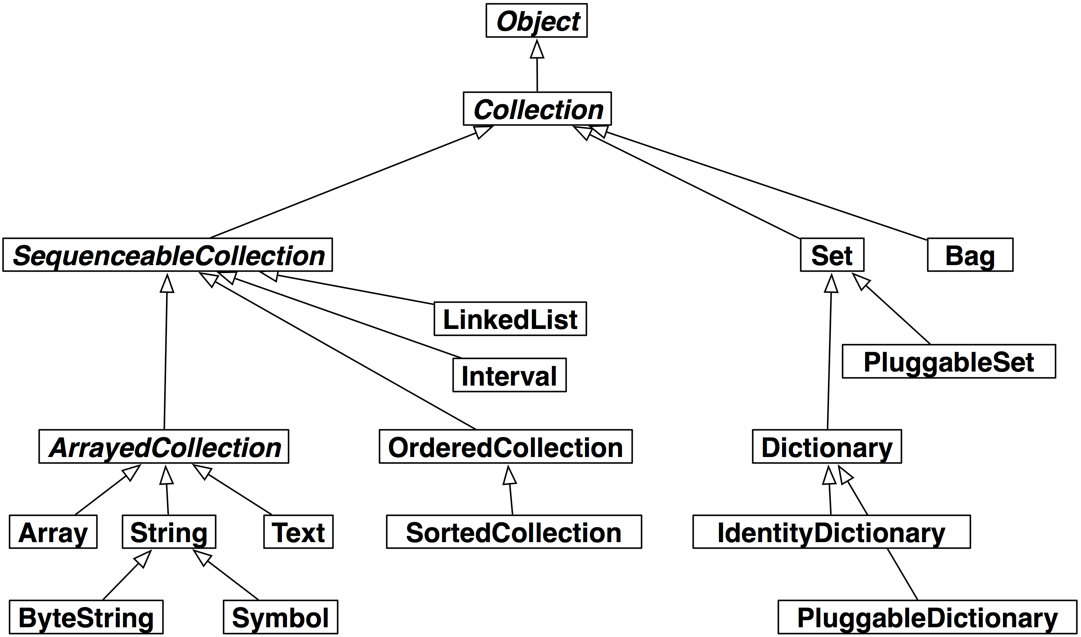
A selection:

Slide 63
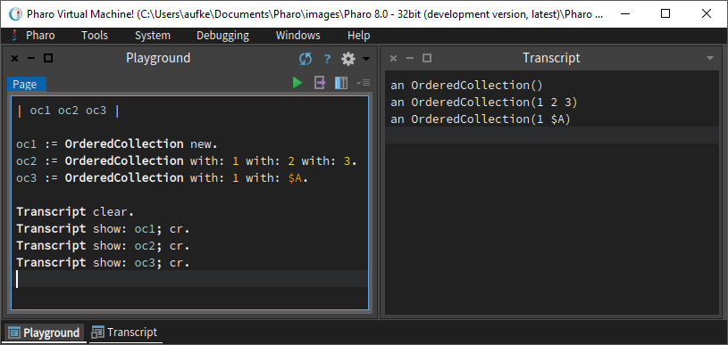
Ordered Collection
Similar to Java ArrayList. Acts as an expandable Array.
Can initialize as empty
Or with some initial elements
Can be heterogeneous!
Transcript knows how to print them

Slide 64
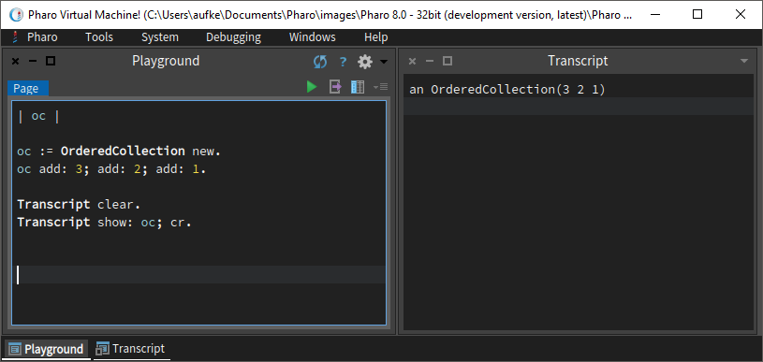
Ordered Collection: Add Elements
Send message add: to an OrderedCollection object.
Argument is the object to append.
Here we cascade several adds.

Slide 65
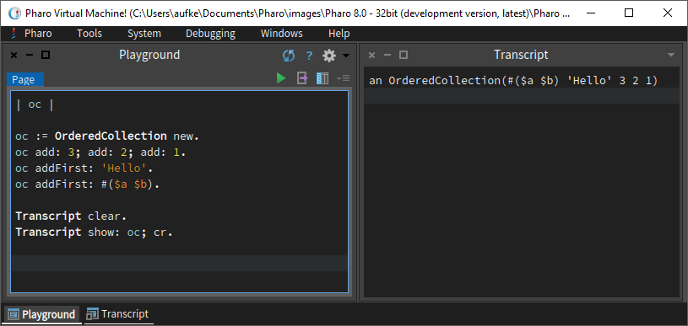
Ordered Collection: Add Elements
Notice we can add a whole array!
Arrays are objects, just like integers.

Slide 66
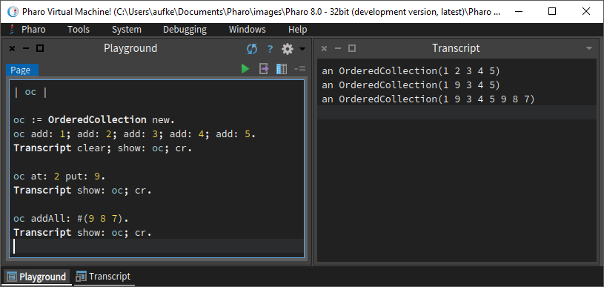
Ordered Collection: at:put:, addAll:
Notice! addAll: adds the elements of an array, not the array itself.

Slide 67
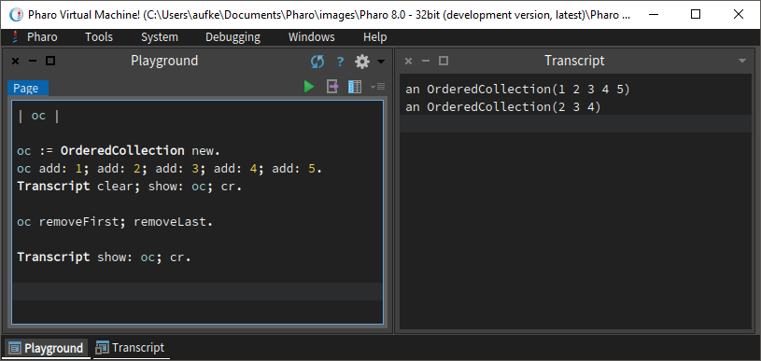
Ordered Collection: Removing

Slide 68
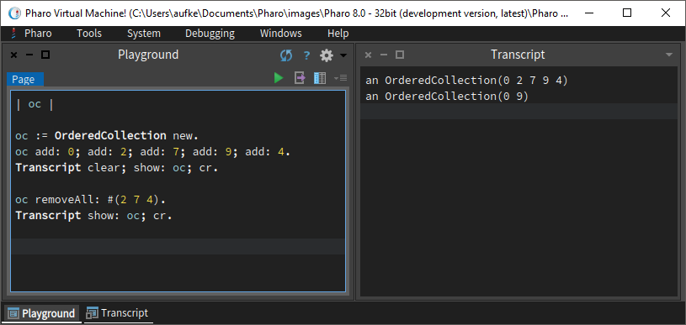
Ordered Collection: Removing
Remove values. Not indexes!
Runtime error if value doesn’t exist

Slide 69
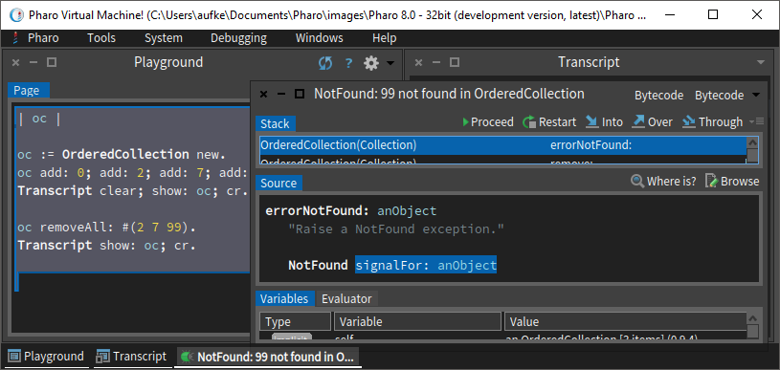
Ordered Collection: Removing

Slide 70
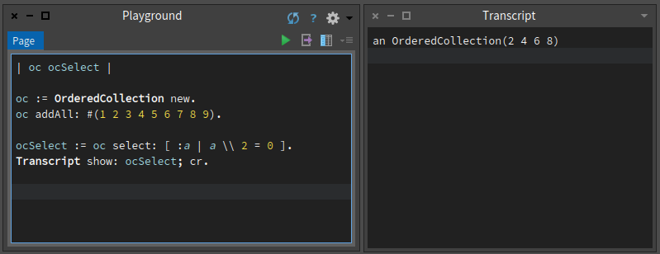
Ordered Collection: select:
Filter collection based on some criteria.
Result is a collection containing elements that pass condition.

Slide 71
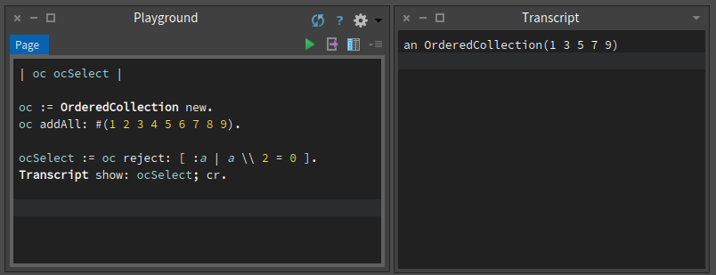
Ordered Collection: reject:
Filter collection based on some criteria.
Remove elements that pass the condition.

Slide 72
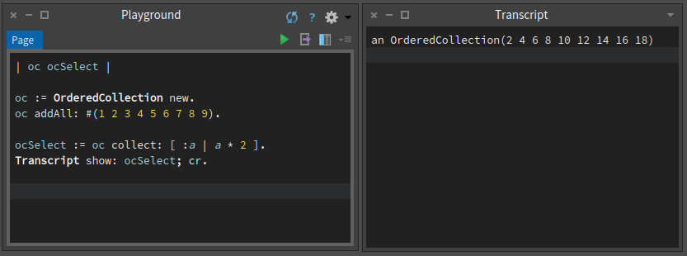
Ordered Collection: collect:
Transform each element in collection.
i.e. perform some operation on each element.

Slide 73
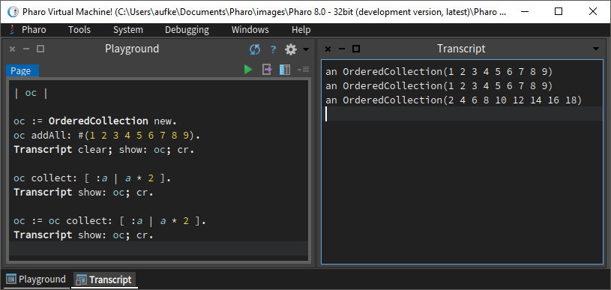
Are we mutating the original?
Nope.

Slide 74
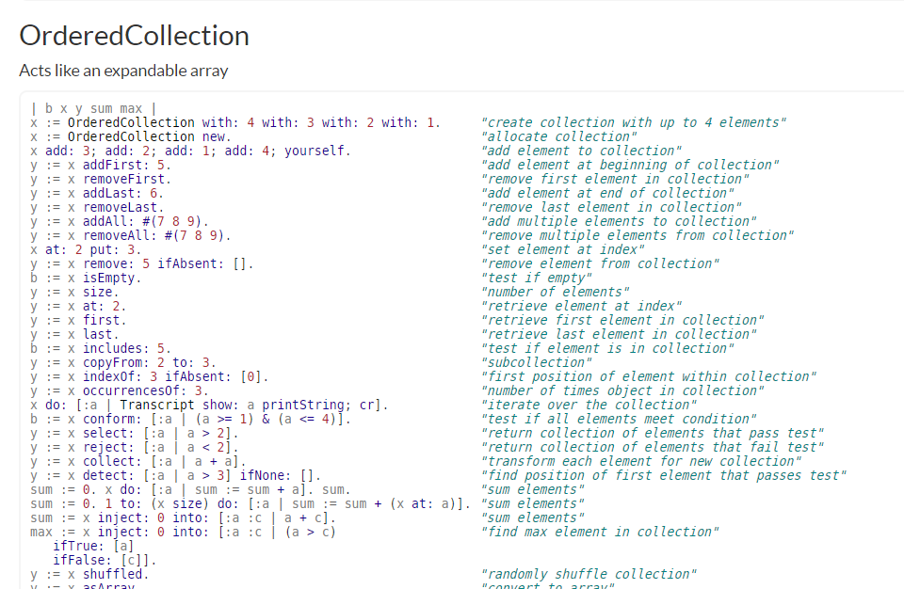
And More!

Slide 75
Sorted Collection
Similar to an OrderedCollection, but, you know, sorted.
Operations are all very similar to OrderedCollection, but here we can specify a sorting criteria:
[:a :c | a <= c]
A block with two inputs, that implement a Boolean condition.
Uses this condition to sort using heapsort/quicksort.

Slide 76
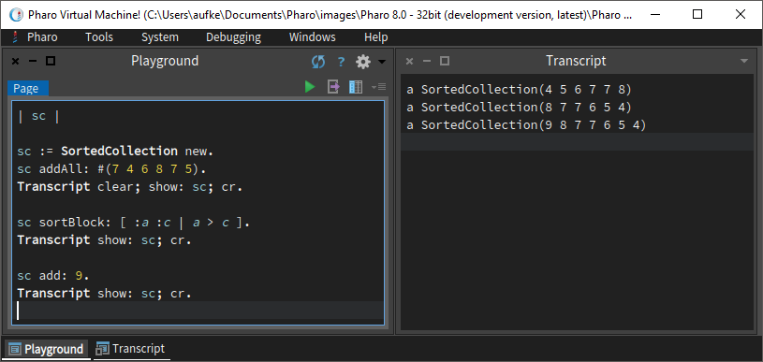
Sorted Collection
Default sorting behavior is ascending order
[:a :b | a <= b]
We can change that to descending order
Condition can be anything that results in a Boolean
Operations on a SortedCollection trigger re-sorting.

Slide 77
Sorted Collection
Default sorting behavior is ascending order
[:a :c | a <= c]
This is a block that evaluates to Boolean when executed
We’re defining the condition for a appearing before c in the sequence
Ascending order: a comes before c if a is less than or equal to c
If block is true, a comes first.
This is just like implementing a compareTo() method in Java

Slide 78

Sorted Collection
Silly sorting criteria?
[:a :b | a \\ 2 = 0]
a comes before c if a is even

Slide 79

Modifying collection triggers re-sorting

Slide 80

Dictionary
Arrays are indexed with integers, Dictionaries are indexed with any object at all.
You’ll know exactly how this works if you learned Python in CCPS 109
Store key/value pairs, where key can be anything.
Very powerful, but we give up ordering (Hash set implementation)

Slide 81

Dictionary: Adding Entries
Add data to dictionary using at:put: message
Notice, keys/values can be any object.
String object as key, integer object as key.

Slide 82


Dictionary: Getting Value with Key
Access entries using at: message

Slide 83


Dictionary: Key not Found?

Slide 84

Not very graceful…
Try at:ifAbsent: instead
Block argument gets executed if entry isn’t found
Block does nothing, nil gets passed as argument to show:
No more run time error.

Slide 85


Dictionary: Printing

Slide 86
Identity Dictionary
When searching for a key in a regular dictionary, the result of the = and hash messages are used.
I.e., hash to index into table, compare key to resolve collision
Remember hash tables from CCPS 305
An Identity Dictionary uses == message, which checks if the key is the same object
Other than that, methods are the same
Identity dictionary works great with symbols, less so with strings. Why?
Identical strings are not necessarily the same object!

Slide 87
Symbol Reminder
Symbols:
# followed by string literal
#‘aSymbol’ same as #aSymbol (no whitespace, quotes implied)
#‘symbol one’ #‘symbol two’
Symbols are globally unique. Strings are not.
Meaning:
Two identical (value) strings can exist as two different objects
For every unique symbol value, there can be only one object.

Slide 88

Identity Dictionary
Same key value, different object

Slide 89

With Symbols?

Slide 90

And much more!

Slide 91

Point

Slide 92



There are many other classes for you to explore:

Slide 93
Streams
Streams in Smalltalk are similar in concept to streams in Java.
We can read/write from/to Strings, arrays, files, etc.
We’ll look at WriteStream, and very briefly ReadStream.
FileStreams are very similar in principle.

Slide 94

WriteStream: Creation
Two ways:
Pass String (or Array, etc.) as argument with on: message to WriteStream
Create a new array (or string), pass it unary writeStream message.

Slide 95

WriteStream: Usage
nextPutAll:
Add all characters/elements from a string or array
nextPut:
Add a single character or element

Slide 96
WriteStream: Usage
contents
Get contents of stream.
Comes in the form of a String or an Array, depending on how the stream was created.

Slide 97

WriteStream: Usage
Use class message to check!

Slide 98

WriteStream: Usage
Pull out contents as an array, use the same way we would any other array.

Slide 99

ReadStream?
Can be constructed from an existing array or string.
Use next to get next element, atEnd to check if elements remain

Slide 100

Streams: Other Messages
As always, explore and experiment

Slide 101

What is Transcript Anyway?

Slide 102

Transcript as a Stream
Sending nextPutAll: to Transcript is not enough to make it print.
We have to send flush to ensure this.
flush can also be sent to WriteStream

Slide 103

Transcript show:
Using show: ensures print occurs. Why?
Three more messages

Slide 104

Transcript show:
print: simply calls nextPutAll:
Convert object to string for printing

Slide 105

endEntry
Down the rabbit hole… critical:

Slide 106

ThreadSafeTranscript means safe for multithreading
Multiple threads can print to transcript safely, no race condition or deadlock

Slide 107

Method “Overloading”

Slide 108

Method Overloading
In Java, methods are overloaded by defining different parameter lists:
In Java, method name and parameter list are independent.
In Smalltalk, they are fundamentally linked

Slide 109
Method Overloading
In Smalltalk, there is no overloading in this fashion.
We cannot have a single message that optionally accepts differing numbers of arguments.
When we add another argument, the method/message name changes.

Slide 110

Method Overloading
When we add another argument, the method/message name changes.
value and value: are different names
value: and value:value: are different names
And so on

Slide 111
Method Overloading
All well and good, but what about the same number of arguments with different types?
In Java, compiler sees these as different:
public int add(int x, int y)
public double add(double x, double y)
In Smalltalk, argument types aren’t checked upon message pass.
Invoking a method (passing a message) only fails when receiving object can’t handle the message.
We get a runtime error in the body of the method if the argument type is incompatible.

Slide 112

Method Overloading
However! The following code succeeds!
Pass + message to SmallInteger 3 with SmallInteger argument 4
Pass + message to SmallInteger 3 with BoxedFloat64 argument 4.0
Same message, same receiving class, different kind of argument. How?

Slide 113

Let’s Investigate!
Invoke superclass addition

Slide 114


Slide 115

Check if argument is integer.
If so, it’s an integer expression and we can react accordingly
Check if operands have same sign
negative returns Boolean
digitAdd: and digitSubtract: define the bitwise arithmetic for performing addition!
Very cool that we can actually see this.

Slide 116


Slide 117
If arg isFraction, we can still add precisely using numerator and denominator
If arg is neither fraction nor integer, we send it adaptToInteger:andSend: message

Slide 118

adaptToInteger:andSend:
Convert original receiving integer to floating point
Perform addition between two BoxedFloat64

Slide 119
Double Dispatch
Method overloading not possible in Smalltalk.
Uses the previous technique instead, called double dispatch
Double Dispatch:
Broadly: Make additional method/function calls based on the types of the objects involved in the original call at runtime.
I.e., if arg is float, invoke method for floating point addition.
Overloading is done at compile time, double dispatch occurs at runtime.

Slide 120
Double Dispatch
Overloading is decided at compile time, double dispatch at runtime.
In Smalltalk (double dispatch), the same method gets invoked regardless of the argument type. Same message regardless!
Secondary method call(s) occur in the body of the first method, depending on argument type.
In Java, a different method gets invoked from the very start depending on the type of the argument.
Decided at compile time.
Explore this on your own for some of the other types and operators

Slide 121

This concludes your Smalltalk crash course!
Let’s finish with a high level summary.

Slide 122


Smalltalk Syntax
Extremely minimalist:
Only five reserved “keywords”: true, false, nil, self, super
Java has 50, C++ has 82, C has 32
There is an adage – “Smalltalk syntax fits on a postcard”

Slide 123

“Smalltalk syntax fits on a postcard”
Method with argument:
Unary messages
Binary messages
Temporary variable
Block
Heterogeneous array
Keyword message
Pass do: message with block argument to array
Return result

Slide 124

Smalltalk Extensibility
We are free to modify core Smalltalk classes and methods:

Slide 125

Amuse your friends! Confound your enemies!
We are free to modify core Smalltalk classes and methods:
Beware: You WILL cause havoc and be forced to create a new Pharo image.
The Pharo live environment is using these very methods in a JIT fashion.
Changing True to False means Pharo itself thinks True is False.

Slide 126
Smalltalk Semantics
“A compiler will complain about syntax, your coworkers will complain about semantics”
Always remember:
Everything is an object
Computation is done by passing messages to objects.
Message precedence: unary, binary, keyword.
Equal precedence evaluates left to right
Everything else follows from these principles.

Slide 127
Smalltalk Pragmatics
Has garbage collection (like Java)
Best-in-class IDE (according to fans).
Class browser, playground, debugger, transcript, etc.
Just-in-time compilation (JIT)
Code executed in a live environment
Image-based development

Slide 128
Smalltalk popularity? A dead language?
https://medium.com/smalltalk-talk/who-uses-smalltalk-c6fdaa6319a
JPMorgan Chase:
“Around the time that Java was just being introduced to the world, the banking giant rolled out a new financial risk management and pricing system called Kapital, written entirely in Cincom Smalltalk.”
“JPMorgan estimates that developing and maintaining this system in any other language would’ve required at least three times the amount of resources.”

Slide 129
Smalltalk popularity? A dead language?
https://medium.com/smalltalk-talk/smalltalk-and-the-future-of-the-software-industry-3f69cac13e5a
“One of the goals of Smalltalk was to make it very easy to teach programming to children.”
“I believe the best way to teach beginners how to program is with a good teaching language. Languages like Java, Python, JavaScript, C#, C/C++, PHP, Ruby are all industrial languages; they carry a lot of industrial baggage that can get in the way of a beginner.”

Slide 130
Smalltalk popularity? A dead language?
https://www.quora.com/Why-did-the-Smalltalk-programming-language-fail-to-become-a-popular-language
“The popular story that's been around is that Sun killed Smalltalk with Java. That seems to be partly true…”
“I think what prevented Smalltalk from increasing in popularity was the popularity of developing for the internet…”
“The dominant idea in the Smalltalk community in the '90s was that it was a GUI desktop platform, and that's where it should stay.”

Slide 131

2017
Loved: % of people currently using that want to keep using

Slide 132

2018
Smalltalk disappears.
Not sure why, but I think they didn’t include it in the survey.
Rust still on top!

Slide 133


2018
Dreaded: % of people currently using that no longer want to.

Slide 134

2018
Wanted: % of people not using who want to use
Important!
This refers to what individual developers want to use.
It does not necessarily reflect what the market wants

Slide 135

https://spectrum.ieee.org/at-work/innovation/the-2018-top-programming-languages

Slide 136

Next Week:

